Slide 1

Aligning Decision Support and Data Analytics
- Supervisor: John Keane
Background:
• An MCDM approach, Analytic Hierarchic Process (AHP) , allows decision makers to rank information based on pairwise comparison (PC) of several criteria. PC enables users to formalize preferences by specifying relative importance of different criteria. Users specify relative priority between pairs of criteria, a widely used approach in decision support with available tool support. AHP considers results whose merit is explained not just with respect to overall utility, but also because they more closely match a user’s preferences.
• PC allows systematic and transparent elicitation of preferences over a set of criteria. Consideration of a pair of elements at a time induces a separation of concerns to help achieve an accurate reflection of user preference.
• In a multi-criteria scenario, cast as a multi-dimensional optimization problem, a range of possible trade-off solutions exist. In each solution, improvement in one objective decreases one or more other objectives. User preferences are used within an optimisation framework to search for a solution that is most fit for purpose.

Slide 2
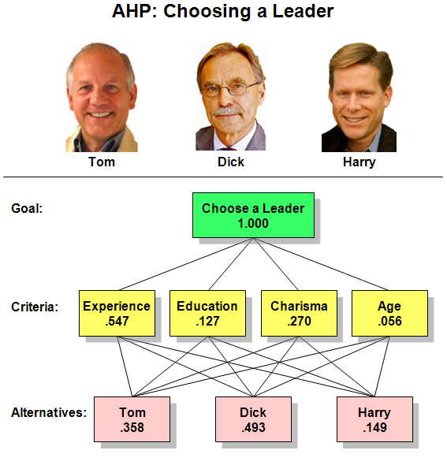
How AHP works
Three steps of AHP:
Model the problem as a hierarchy
1.1 hierarchy defined
1.2 hierarchies in the AHP
2. Evaluate the hierarchy
3. Establish priorities
3.1 priorities defined and explained
02-04-2020 week 1

Slide 3
Project timeline
 | Feb | Mar | Apr | May | June | July | Aug
Preparation & planning
Understand the project & method
Data collection
Development & testing
Specify detailed requirements
Develop prototype
Approve prototype
Train beta model
Test beta model
Approve final model
Documentation
Dissertation draft
Final dissertation
Milestone 1
Milestone 2
Milestone 3
02-04-2020 week 1

